Slide 1
Predicting Sales using ML Analysis of Past Consumer and Economic Behaviors
IAI 5101 Group 15
Presenters: Aron Arany-Takacs, Hassan Megahed, Adam Lyu, Sonam Rinchen, Maryam Kian
Notes:
Aron

Slide 2
Contents
Problem Formulation
Introduction
Detail Process
Data Collection & Preprocessing
EDA & Visualization
Feature Engineering
Model Implementation
Model Evaluation
Concluding Remarks
Notes:
Aron

Slide 3
Problem Formulation
Can consumer behaviours be predicted based off historical sales data, along with overall economic conditions and trends?
What indicators can be used to refine this prediction?
Is there a link between distinct components of the economy and seemingly unconnected segments of the consumer goods industry?
Notes:
Aron

Slide 4
Introduction
Our team aims to forecast changes in the sales and profit of specific goods with respect to market changes using features tied to customer spending behavior and prevailing economic conditions.
The Consumer Price Index (CPI) historical data logs provide insight into general consumer economic trends over time
Different categories of goods may experience varying levels of influence due to these trends
Our team aims to explore these relationships and draw accurate conclusions using modern ML and DL techniques.
Notes:
Aron

Slide 5
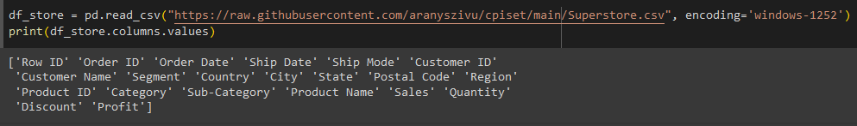
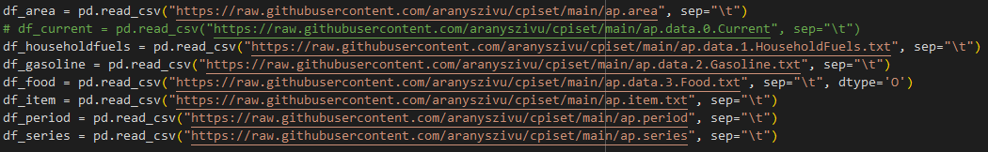
Data Collection & Preprocessing
Two Primary Data Sources:
SuperStore data set
Average Product CPI data set
Notes:
Aron

Slide 6
Process Stages:
Superstore
Load & trim Superstore data set
Derive prices per unit sold & profit rates per product
Standardize foreign keys
Standardize data for US Regions (group cities, metro. areas, etc.)
CPI
Import raw CPI text files
Merge header & data sheets using keys
Group by region, rebase values to S.S. set keys
Trim to relevant date subset
Rename attributes & values to match main Superstore set
Merge each CPI Product table into main set
Final Data
Find month-over-month changes in CPI
Standardize column names, cleanup
Notes:
Aron

Slide 7
Final Columns:
profit_rate: The profit rate by the retailer of the product. [Target Attr.]
year: The year the order was made.
month: The month the order was made.
region: The region where the order was made.
category: The overall category of the product.
subcategory: The subcategory of the product.
consumer_price: The price paid by the end consumer.
cpi_food_value: The CPI value for food at the time of the order.
cpi_food_change: The change in CPI value for food compared to a base period.
cpi_fuels_value: The CPI value for fuels at the time of the order.
cpi_fuels_change: The change in CPI value for fuels compared to a base period.
cpi_gas_value: The CPI value for gas at the time of the order.
cpi_gas_change: The change in CPI value for gas compared to a base period.
Notes:
Aron

Slide 8
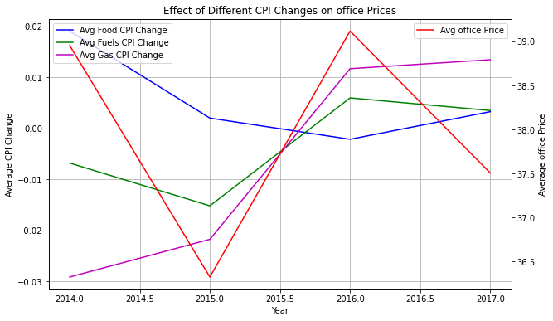
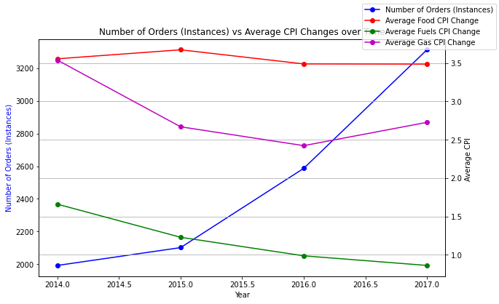
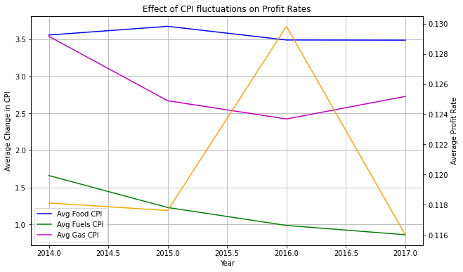
Key Insights from Exploratory Data Analysis
Proportional relationship between price and cpi change
Profit peaked at gas CPI’s lowest point
Disproportional relation between no of orders and Gas/fuel CPI
Notes:
Hassan

Slide 9
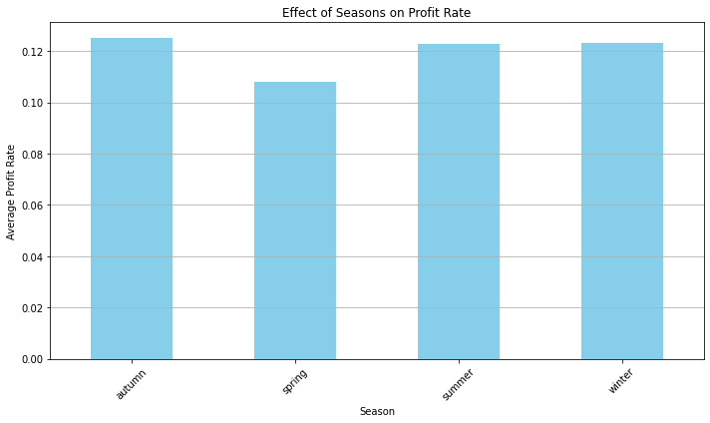
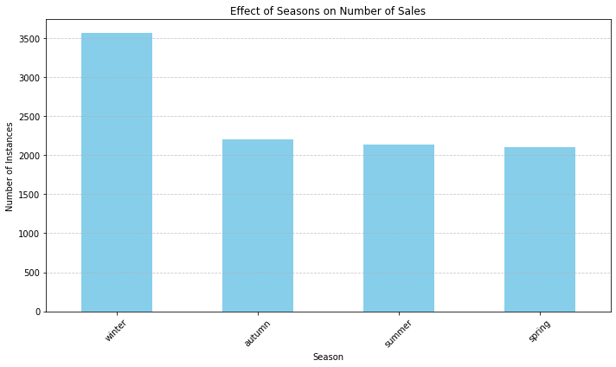
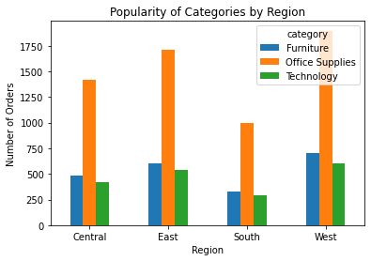
Benefits
Data-driven decisions regarding:
pricing strategies
inventory management
and marketing campaigns
Ultimately optimizing their performance and profitability

Slide 10
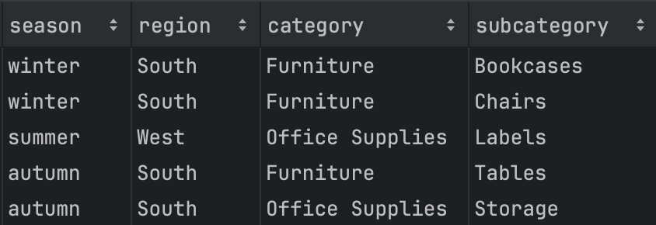
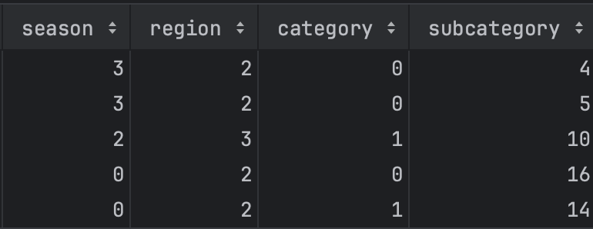
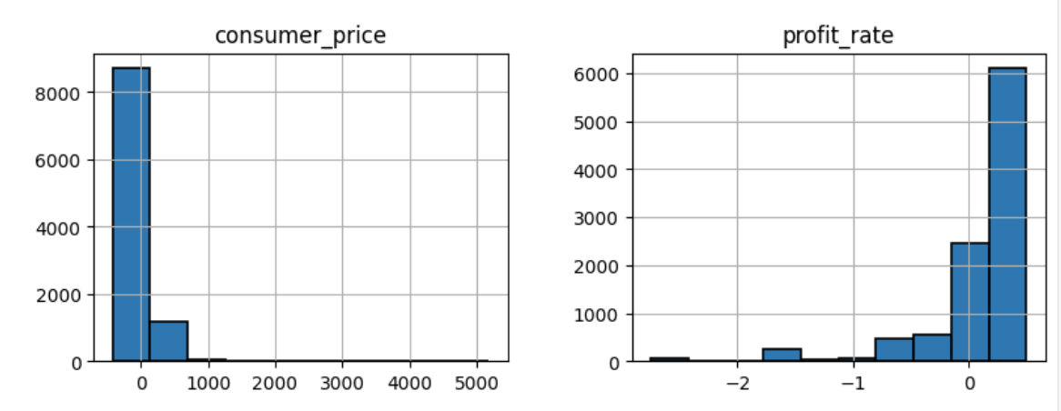
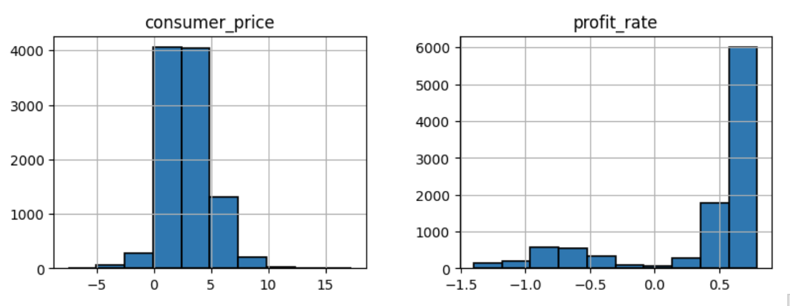
Feature Engineering
Computable Features:
Label Encoding
Feature Enhancement:
Transforms & Normalization
MinMax Scaling
Notes:
Adam

Slide 11
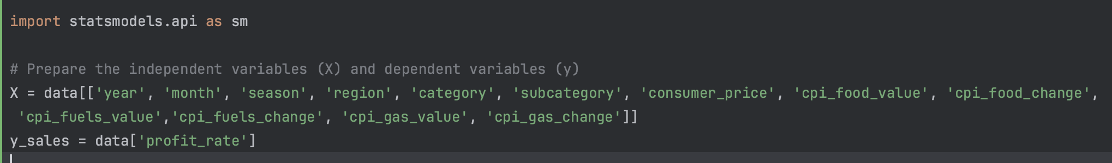
Feature Engineering
Feature Expansion:
cpi_xxx_value (fuels, food, gas)
Decomposing Complex Features
Date -> season / month / year
Location -> region (Central, East, South, West)
Derived Features
profit_rate （target）
season
cpi_xxx_change (fuels, food, gas)
Notes:
Adam 1. ML algorithms expect features to be low-level values

Slide 12
Model Implementation
Models
Regression Model
SARIMA
We developed three models:
A regression analysis model.
A time series SARIMA model for price forecasting.
An LSTM model for price forecasting.
Prepare the dependent variable y = Sales and independent variables X = remaining variables.
Add constant term to the independent variable improves the accuracy and interpretability of the regression model.
Fit multiple linear regression model for Sales.
The dataset is split into 80% training and 20% testing sets.
In SARIMA model parameters autoregression, differencing, and moving average orders for both components, are specified.
The SARIMA model is trained and used to forecast future values in a single step.
Model performance is assessed using MSE between actual and forecasted values.
Notes:
Sonam

Slide 13
Model Implementation
Data Preparation
LSTM Models
Defines an LSTM model for profit rate prediction based on historical data.
Prepares data by creating input-output pairs with a specified number of time steps (n_steps).
Reshapes input data to fit the LSTM model's format.
Splits the data into 80% training and 20% testing sets.
Two LSTM models were created with one layer of 50 units, utilizing a 30% dropout rate and ReLU activation.
The models are compiled using the Adam and SGD optimizers respectively.
Trained on the training data for 50 epochs, validating on the testing data.
Evaluates the models using MSE between predicted and actual profit rates.
Notes:
Sonam

Slide 14
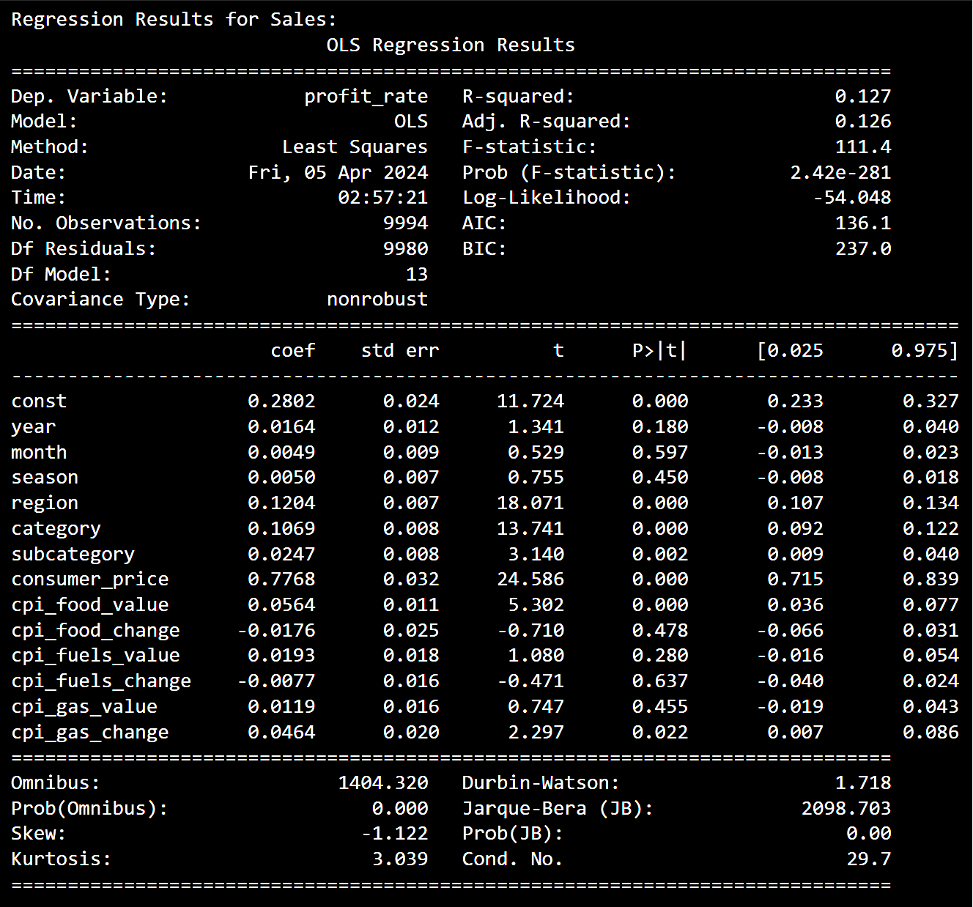
Model Evaluation
Analysis of CPI values VS profit rate
The coefficient for the CPI of overall consumer prices is 0.7768, This suggests that higher consumer prices tend to positively impact profit rates.
For CPI values related to food and fuels, the coefficients are 0.0564 and 0.0193 respectively. And the coefficient for gas is 0.0464. However, changes in CPI for food, fuels, and gas do not display statistically significant impacts on profit rate.
Notes:
Maryam

Slide 15
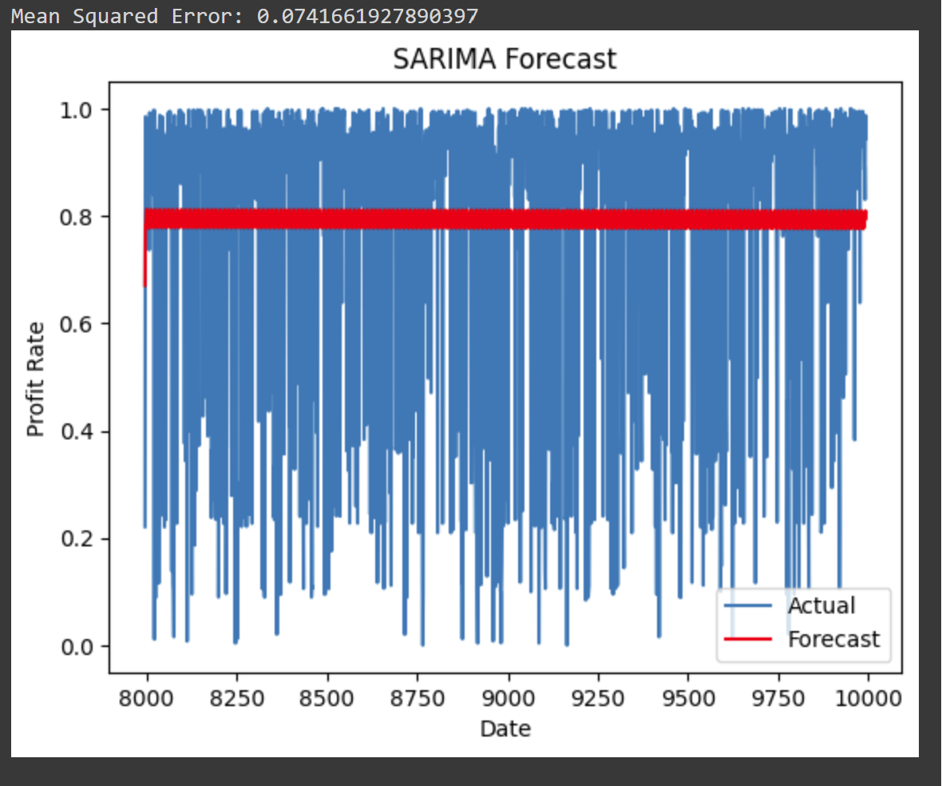
Model Evaluation
SARIMA
MSE value of 0.074 for the SARIMA model indicates the average squared difference between predicted and actual values.
MSE serves as an indicator of the SARIMA model's overall performance. Lower MSE values signify better predictive accuracy, while higher values suggest less accurate predictions.
Notes:
Maryam

Slide 16
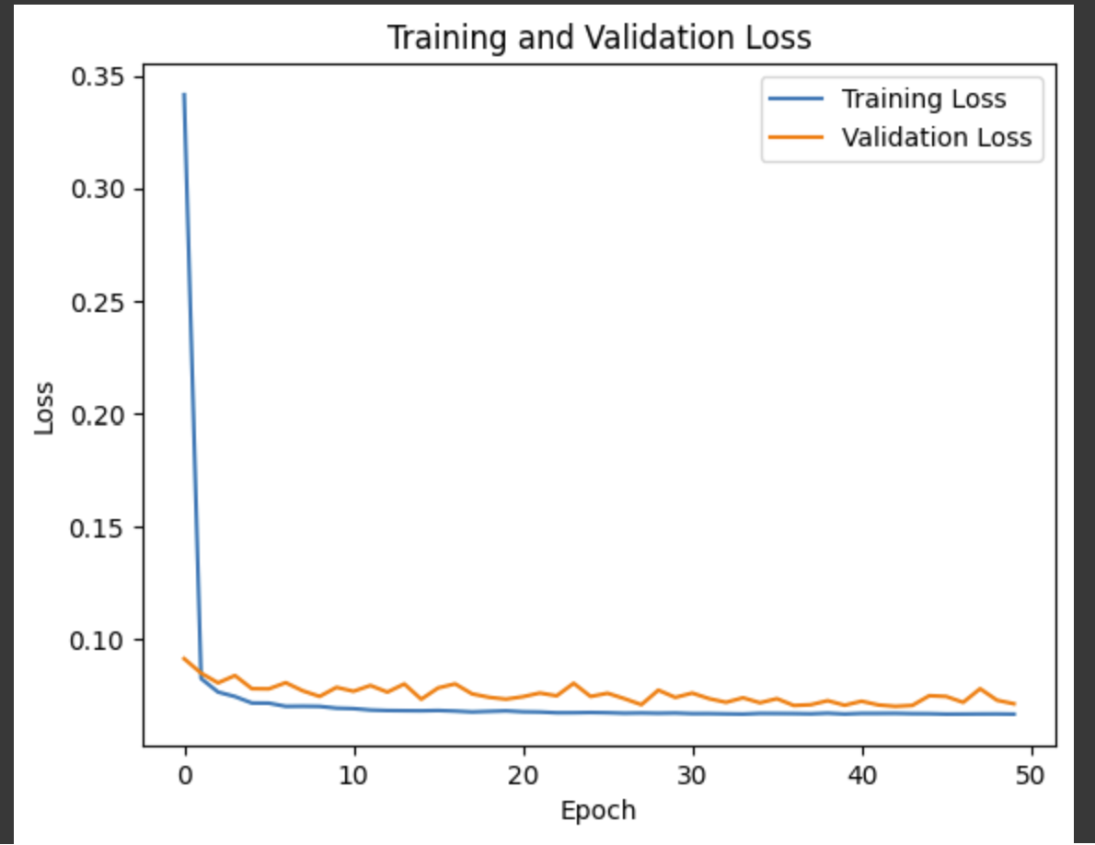
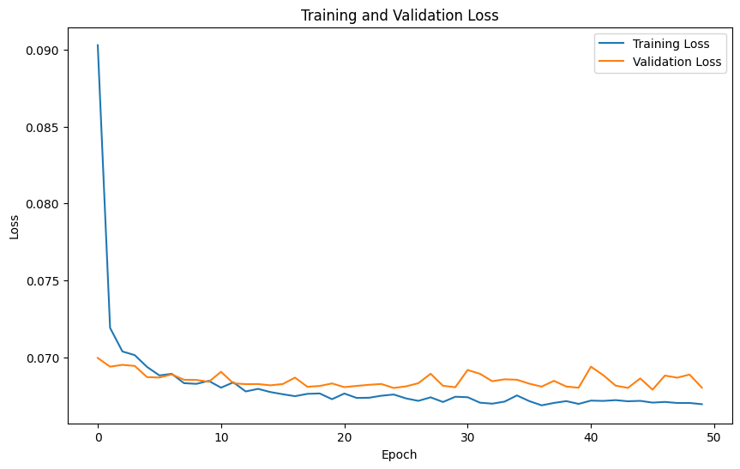
Model Evaluation
LSTM
LSTM model with SGD optimizer performs better compares to ADAM according their respective MSE value of 6.8 % and 7.1 % .
However, according to graph ADAM optimizer generalised model slightly better over SGD. As the validation loss is relatively same to training loss in ADAM.
ADAM
SGD
Notes:
Maryam

Slide 17
Summary & Concluding Remarks
In summary, we developed three models for profit rate prediction.
Our Regression Analysis of Consumer Price Index (CPI) values revealed their significant impact on profit rates.
The SARIMA Model Achieved a low MSE of 7.4 %, showcasing the model's capability in forecasting future price trends.
LSTM Model: With the SGD optimizer outperformed with the MSE of 6.8%, indicating its superior performance over ADAM which has MSE of 7.1%.
In conclusion, the LSTM model with SGD optimizer demonstrated exceptional performance given the limited dataset. However, to further enhance model efficacy, acquiring a larger dataset is imperative.
MODELS | MSE (%)
SARIMA | 7.4
LSTM SGD | 6.8
LSTM ADAM | 7.1
Notes:
Sonam

Slide 18
Thank You
Notes:
Sonam

Slide 19
References
[1] “GDP growth (annual %),” The World Bank (IBRD - IDA), https://data.worldbank.org/indicator/NY.GDP.MKTP.KD.ZG?end=2021&start=2021&view=bar (accessed Jan. 28, 2024).
[2] Priscila, Silvia & Rajest, Suman & Tadiboina, Sai Nitisha & Rajan, Regin & Szeberényi, András. (2023). Analysis of Machine Learning and Deep Learning Methods for Superstore Sales Prediction.
[3] V. Chowdhury, “Superstore dataset,” Kaggle, https://www.kaggle.com/datasets/vivek468/superstore-dataset-final (accessed Mar. 30, 2024).
[4] “Consumer price index (CPI),” Data.gov, https://catalog.data.gov/dataset/consumer-price-index-cpi-ee18b (accessed Mar. 30, 2024).
[5] A. Lyu, A. Arany-Takacs, H. Megahed, M. Kian, and S. Rinchen, “Final_Project.ipynb,” CPISet Project, https://github.com/aranyszivu/cpiset/blob/c2dae3ac2ed671f23eb05ba38ca7896750b5a472/Final_Project.ipynb (accessed Apr. 5, 2024).
Notes:
Sonam

